Slide 1
Credit Value at Risk
Wenyu (Kelly) Shen
December 10, 2025

Slide 2
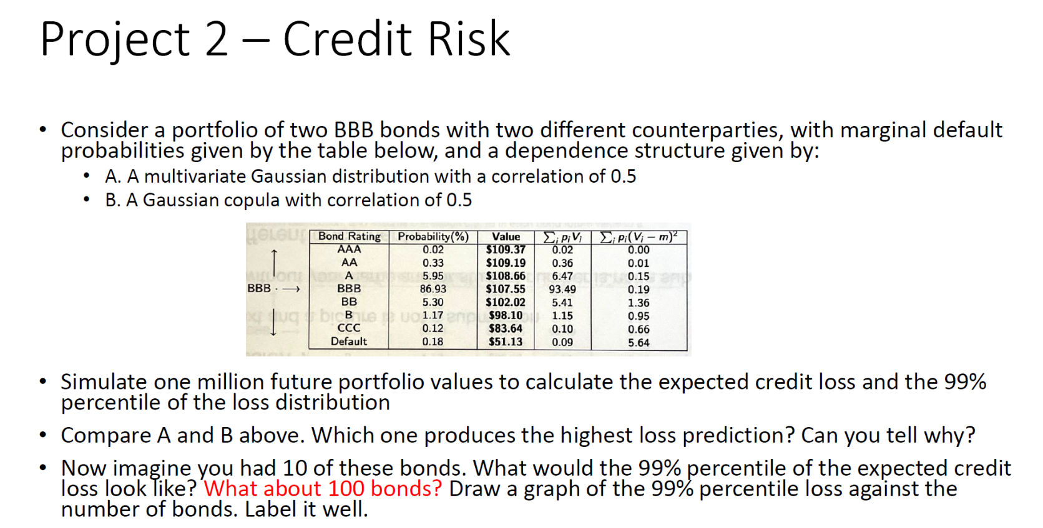

Slide 3
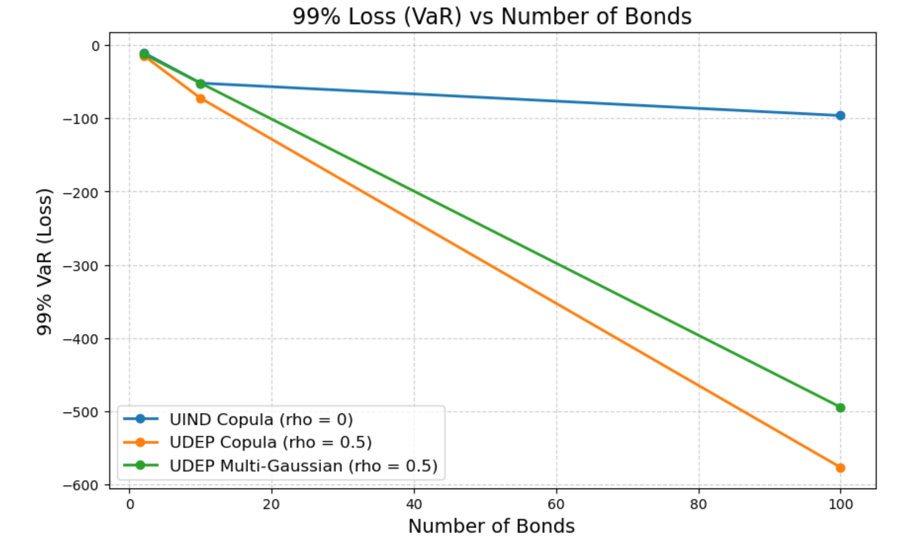
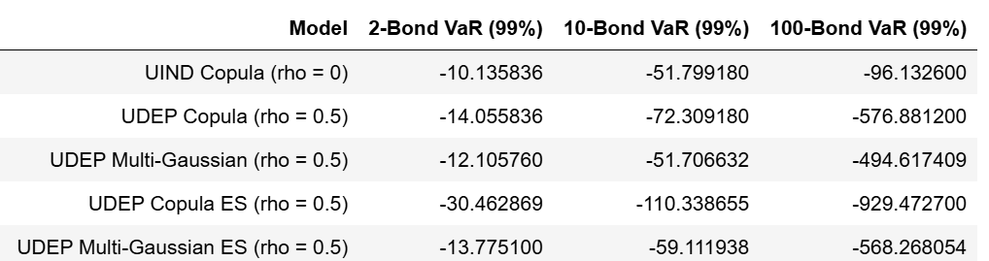
Result
Approach A: Multivariate Gaussian Distribution;
Approach B: Gaussian Copula
Summary: The VaR and ES for approach B is higher than the approach A.
Reason:
For multivariate gaussian, the behind steps is utilized the Cholesky Decomposition and the correlation covariance matrix, to simulate N (# of bonds) normal random variables, that satisfied the correlation requirement. The generated distribution is symmetric, thin-tailed and unable to generate the large downward jumps and underestimates tail risks.
The Gaussian Copula has an extra steps of credit state mapping, and preserves the true discrete credit migration tail risk and and produces higher loss predictions compared with the approach A.

Slide 4
Thank you!

Slide 5
Appendix 1: Code
Notes:
We also did a performance attribution to break down the excess return into asset allocation and security selection effects.
From the graph we can see that our fund underperform the benchmark in both allocation and selection.
The best allocation is the Real Estate sector where we allocate 12% more than the benchmark, but we did bad in allocating the financial sector so it detracted 1.3% value add
For security selection.
For the security selction, the Information Technology manger was able to identify stocks that performs better than the benckmark IT stock which creates 0.4% value add.
However, the energy manager failed at identifying better stocks and we

Slide 6
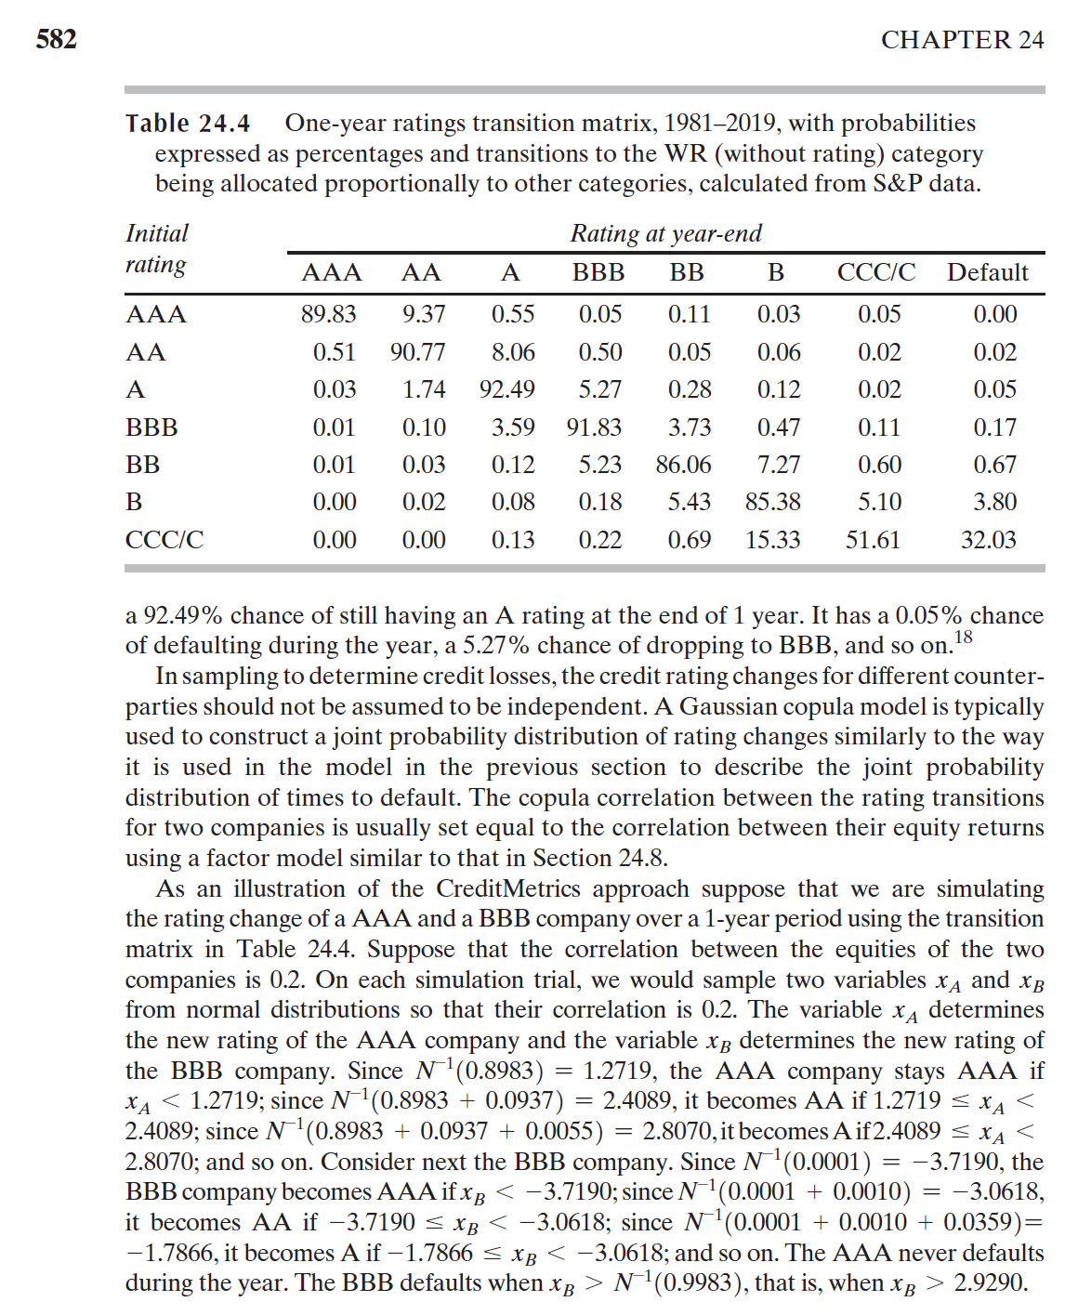
Appendix 2: Examples from Book
Options, Futures and Other Derivatives, John Hull. (Page 582)
Notes:
We also did a performance attribution to break down the excess return into asset allocation and security selection effects.
From the graph we can see that our fund underperform the benchmark in both allocation and selection.
The best allocation is the Real Estate sector where we allocate 12% more than the benchmark, but we did bad in allocating the financial sector so it detracted 1.3% value add
For security selection.
For the security selction, the Information Technology manger was able to identify stocks that performs better than the benckmark IT stock which creates 0.4% value add.
However, the energy manager failed at identifying better stocks and we

